Slide 1


For Beginner
By :- RAHUL JOGRANA
www.dotnetlab.in
www.aspnetinhindi.blogspot.com
Twitter:- @thejograna
Github:- github.com/rahuljograna
Part 12 alerts in ionic

Slide 2

Alerts in ionic
Alerts are a great way to offer the user the ability to choose a specific action or list of actions. They also can provide the user with important information, or require them to make a decision (or multiple decisions).
From a UI perspective, Alerts can be thought of as a type of “floating” modal that covers only a portion of the screen. This means Alerts should only be used for quick actions like password verification, small app notifications, or quick options. More in depth user flows should be reserved for full screen ​Modals​.

Slide 3
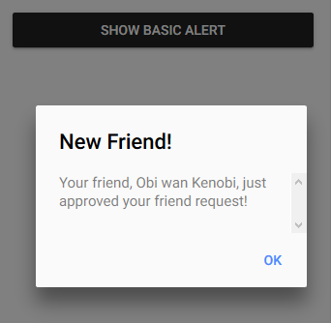
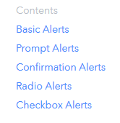
Inputs in ionic

Slide 4
Let’s start

Slide 5
To learn new Technology along with Example like
ASP.NET, ASP.NET MVC, AngularJS, ASP.NET Web API
From Beginners visit my Youtube channel and steps and Source code is
Available on My Blog and Web site
To Get notification for new updates Subscribe my YOUTUBE Channel.
Source Code :- http://aspnetinhindi.blogspot.com
Website :- http://www.dotnetlab.in
Github :- https://github.com/rahuljograna
Twitter :- twitter.com/thejograna
Mail :- rahuljograna007@gmail.com
WhatsApp Number :- 9426585554

Slide 6
To Develop Application
Contact me
Mail me : rahuljograna007@gmail.com
Mobile : +91 9426585554
whatsApp : +91 9426585554

